Slide 1
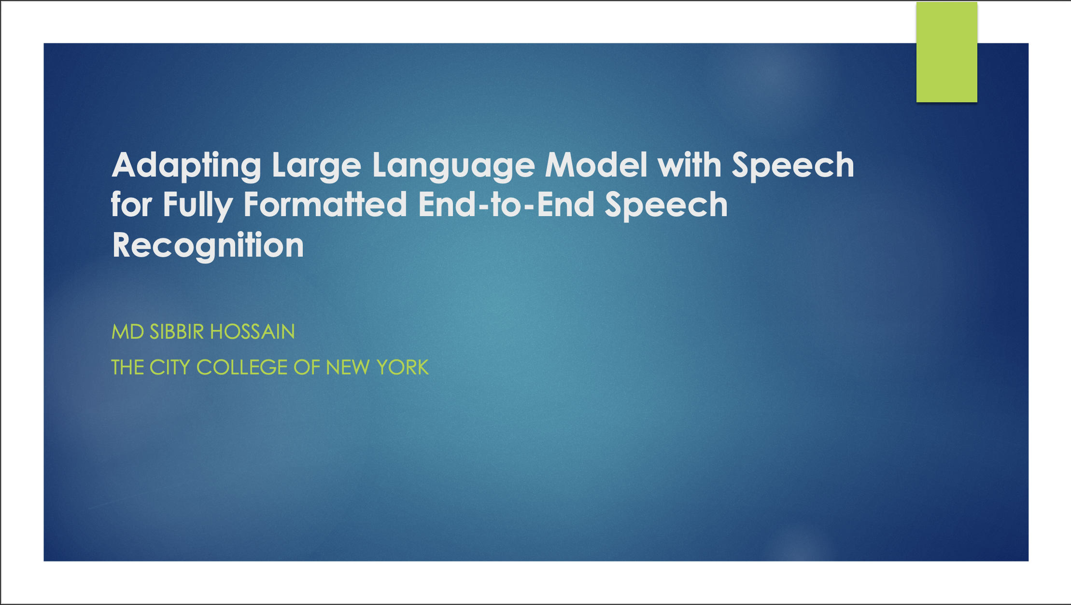
Adapting Large Language Model with Speech for Fully Formatted End-to-End Speech Recognition
MD SIBBIR HOSSAIN
THE CITY COLLEGE OF NEW YORK

Slide 2
Authors: Shaoshi Ling, Yuxuan Hu, Shuangbei Qian, Guoli Ye, Yao Qian, Yifan Gong, Ed Lin, Michael Zeng Affiliation: Microsoft Cloud and AI

Slide 3
Introduction
End-to-end (E2E) speech recognition models typically use encoder-decoder structures.
Pretrained large language models (LLMs) show potential to improve E2E ASR but face integration challenges.
This study explores adapting pretrained LLMs to speech for better formatted transcriptions.

Slide 4
Motivation
Conventional ASR systems require post-processing for formatting (punctuation, capitalization).
Acoustic cues are often underutilized in post-processing.
Aim: Leverage LLMs to directly produce fully formatted transcriptions.

Slide 5
Dataset Used
SPGISpeech Dataset
Contains 5,000 hours of financial audio with high-quality, fully-formatted transcriptions.
Diverse speaker accents (L1 and L2).
Limitation: Domain-specific data, not generalizable.

Slide 6
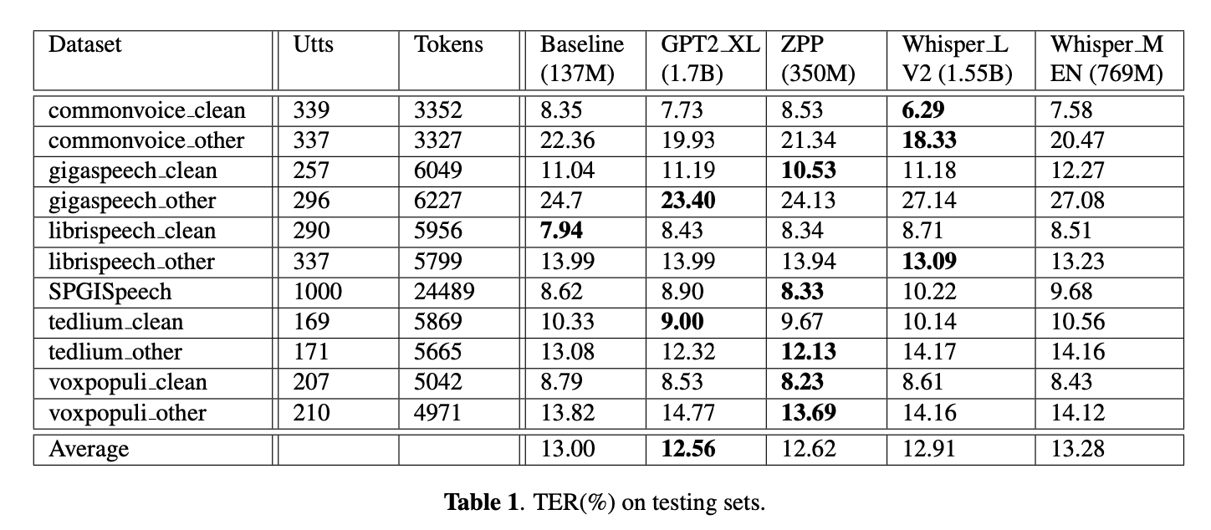
Dataset Used

Slide 7
Related Work
Utilization of text-only data for E2E ASR improvements.
LM fusion methods (shallow fusion, cold fusion, deep fusion).
Challenges in aligning speech and text representations.
Previous works focused on post-processing for formatting.

Slide 8
Proposed Approach
Adapt pretrained LLMs for fully formatted E2E ASR.
Use composable model architecture:
Speech encoder integrated with pretrained LLM.
Encoder-decoder or decoder-only structures.
Aim: Minimal architectural changes for efficient integration.

Slide 9
Encoder-Decoder Based LLM
Integrates speech encoder output with text decoder.
Uses Connectionist Temporal Classification (CTC) for speech representation down-sampling.
Three types of loss used: CTC, Cross-Entropy (CE), Masked Language Modeling (MLM).

Slide 10
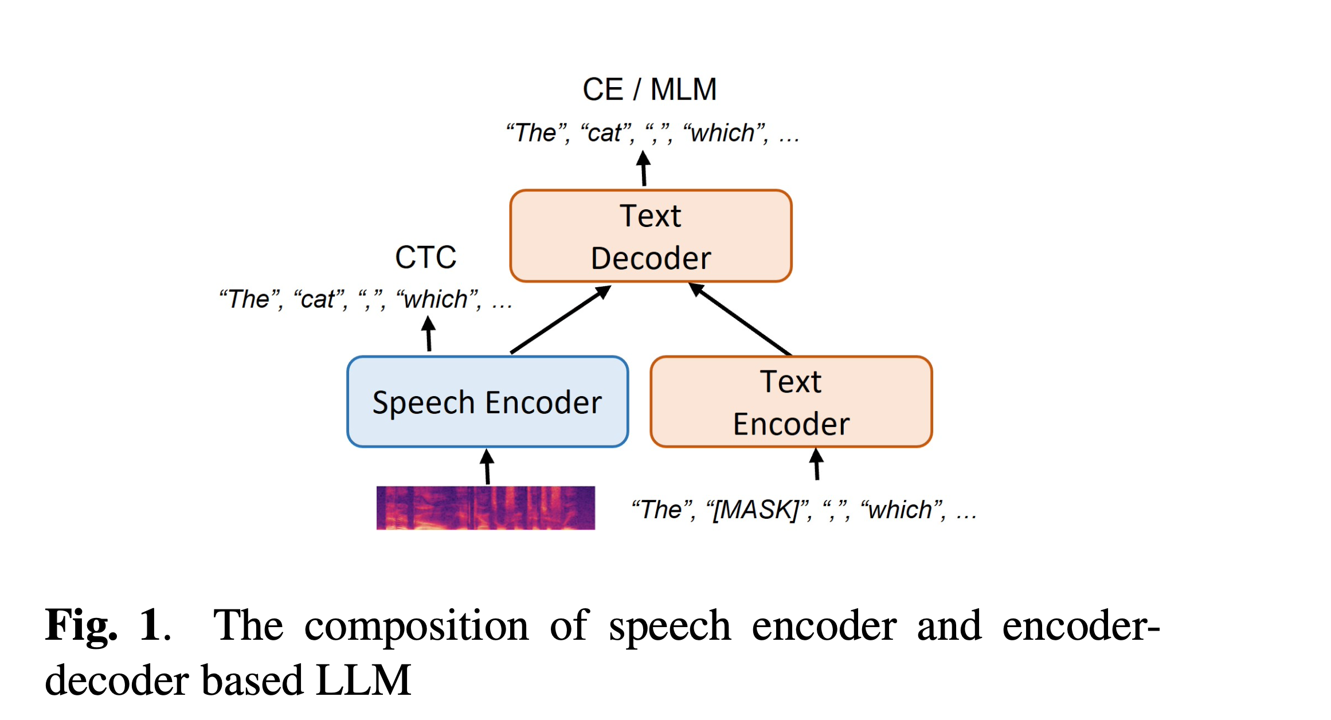
Encoder-Decoder Based LLM

Slide 11
Decoder-Only Based LLM
Utilizes GPT-series models (e.g., GPT-2).
Speech encoder outputs serve as prompts for LLM.
CTC-based down-sampling to address length mismatch.
Minimal changes to pretrained LLM architecture.

Slide 12
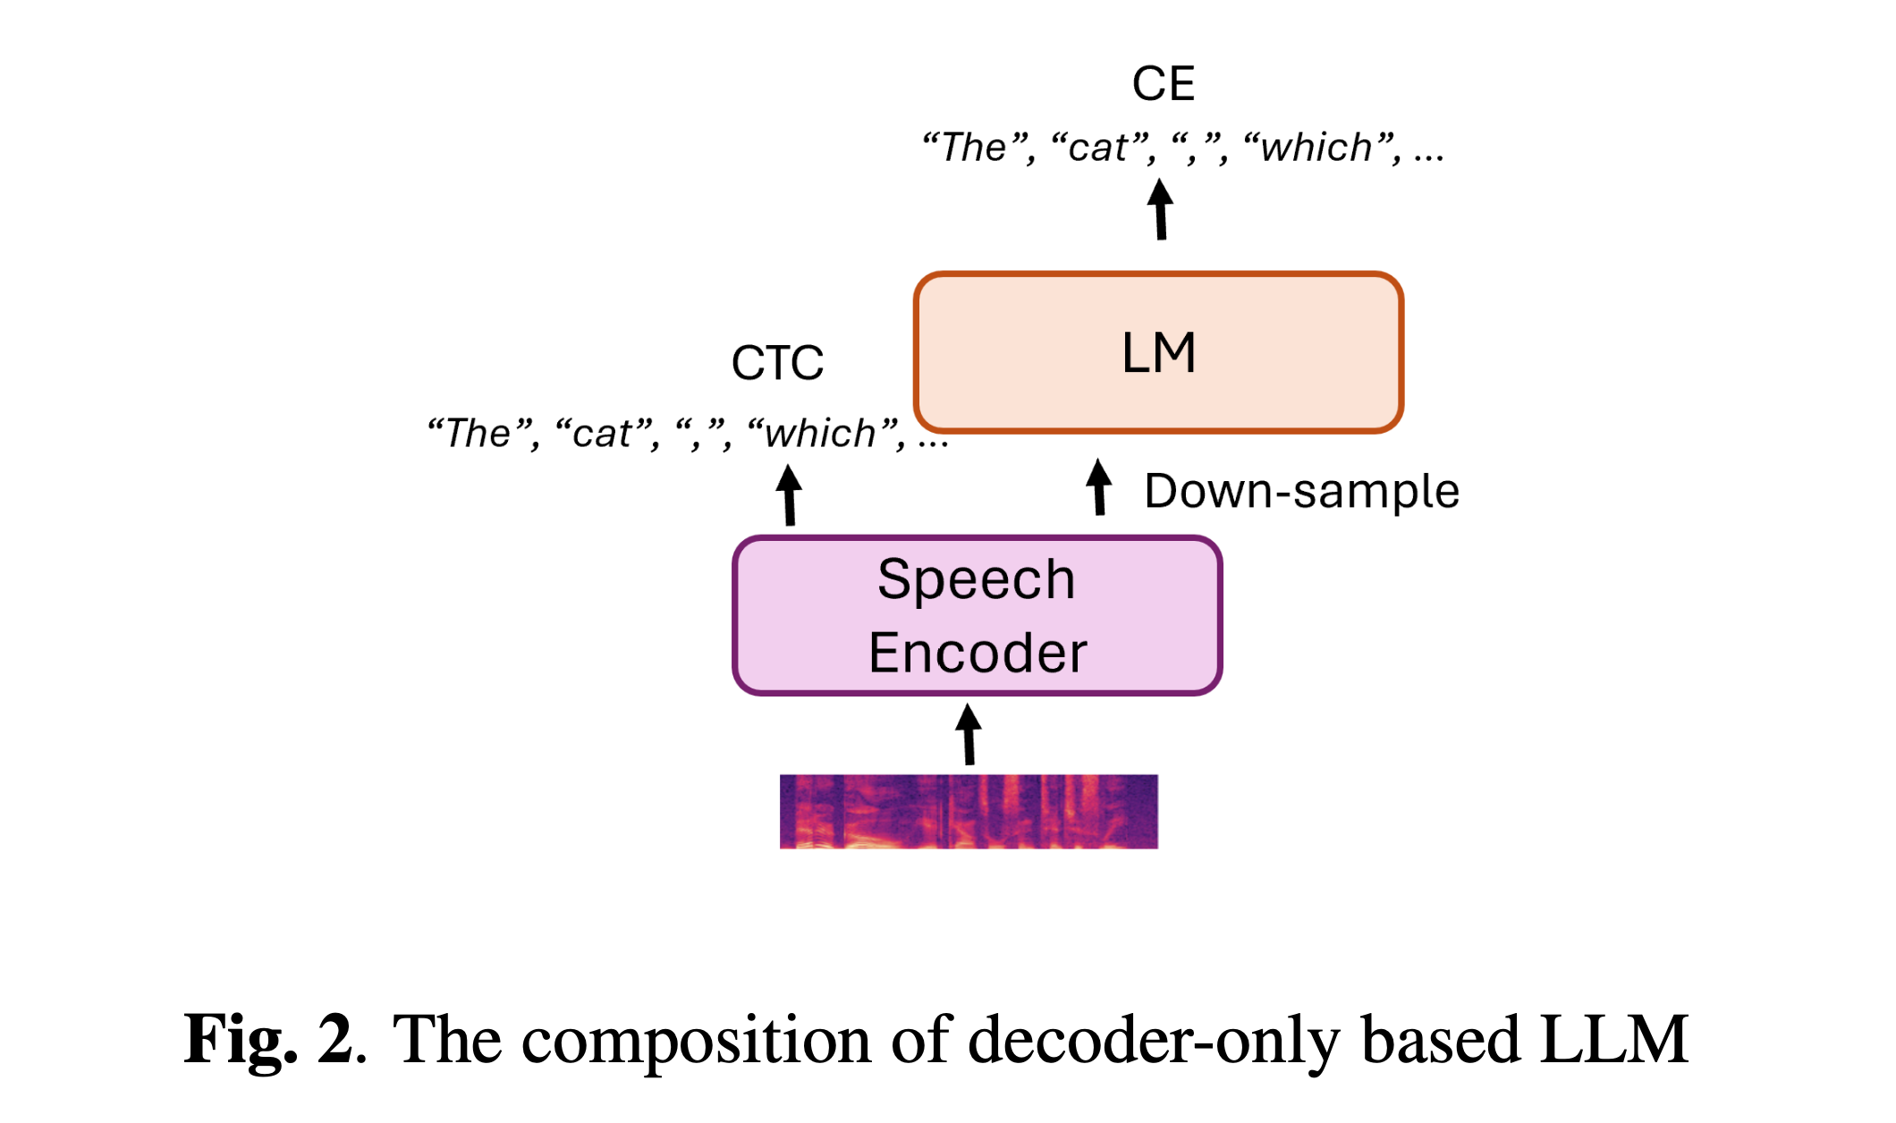
Decoder-Only Based LLM

Slide 13
Experimental Setup
Training Data:75,000 hours of transcribed speech from various domains.
Retains raw text without preprocessing.
Evaluation Data:ESB benchmark's dialogistic dataset (modified for orthographic consistency).

Slide 14
Baseline Model
Attention-based encoder-decoder (AED) model.
Encoder: 24 conformer layers with 8-head attention.
Decoder: 6 transformer layers.
Combination of CTC and attention CE losses.

Slide 15
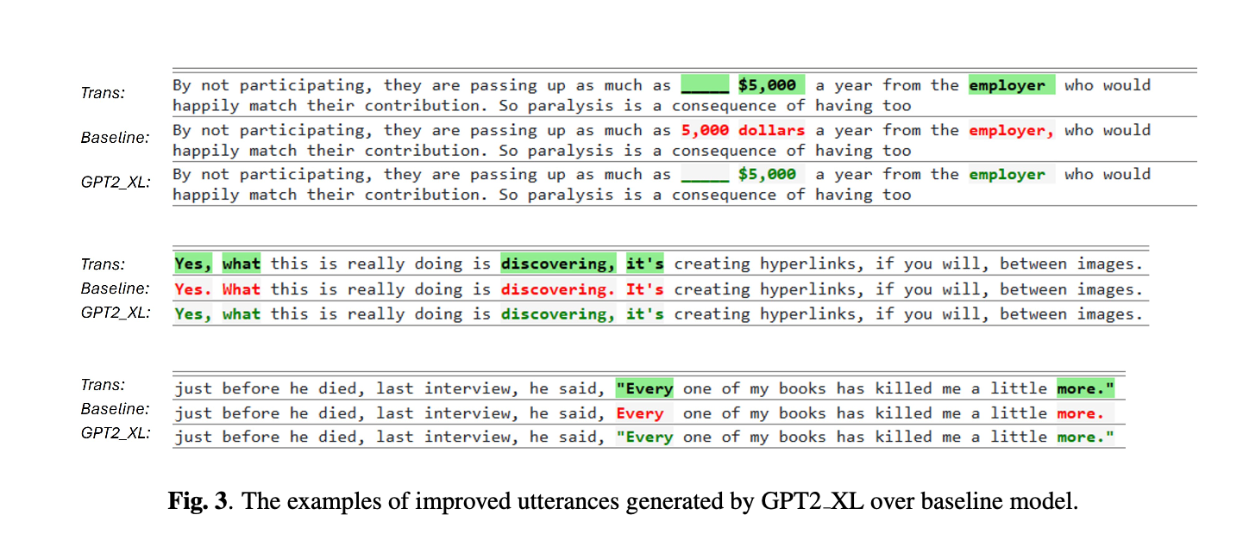
Baseline Model

Slide 16

Adaptation Techniques
Encoder-Decoder Adaptation:
Pretrained Z-Code++ model.
CTC and CE losses on paired data, MLM loss on text-only data.
Decoder-Only Adaptation:
GPT-2 models with LoRA adapters.
Pretraining with CTC loss, then end-to-end training.

Slide 17
Evaluation Metrics
Token Error Rate (TER):
Measures error between predicted and ground-truth transcriptions.
Both punctuation and case-sensitive.
Comparison with public Whisper models.

Slide 18
Experimental Results
Performance evaluated on various datasets (CommonVoice, GigaSpeech, LibriSpeech, SPGISpeech, TED-LIUM, VoxPopuli).
Results indicate improvements in TER across domains with adapted LLMs.

Slide 19
Key Findings
Adapting pretrained LLMs enhances fully formatted E2E ASR performance.
Encoder-decoder and decoder-only structures both viable.
CTC-based down-sampling effectively addresses length mismatch.

Slide 20
Conclusion
First successful attempt to enhance fully formatted ASR transcription using pretrained LLMs.
Demonstrates potential for improved readability and usability in ASR transcriptions.
Future work: Further exploration of multi-domain and generalizable ASR models.

Slide 21
References
https://arxiv.org/pdf/2307.08234v2
Ling, S., Hu, Y., Qian, S., Ye, G., Qian, Y., Gong, Y., Lin, E., & Zeng, M. (2023, July 17). Adapting large language model with speech for fully formatted end-to-end speech recognition.

Slide 22
Thank you

